Slide 1
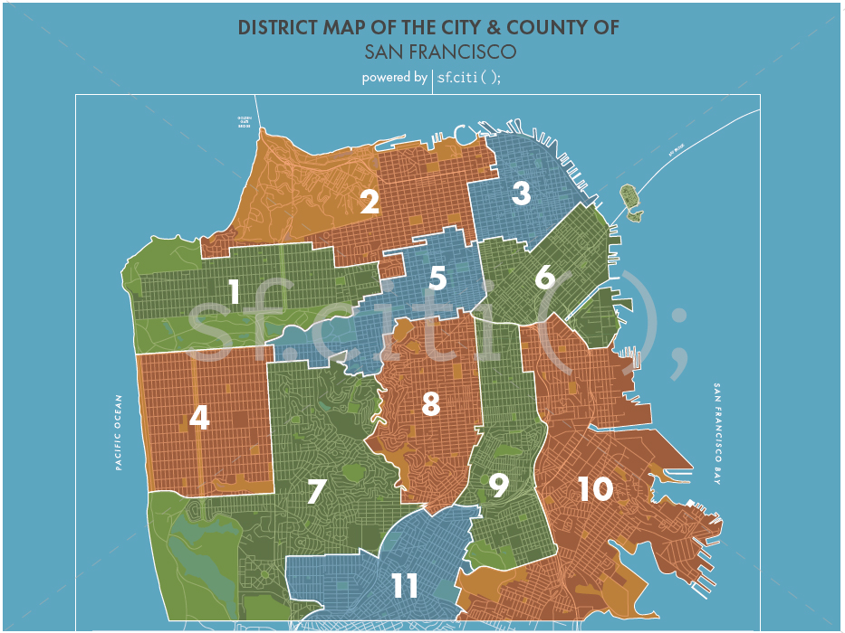

Opening a new sushi restaurant chain in san francisco, CAlifornia
Coursera capstone project - Rey andrew doctora
?

Slide 2
business problem
In this project we found a suitable location for a Japanese chain who will be opening a new brick and mortar restaurant in a new geographic market. The key stakeholder was the Director of Operations who requested opening a sushi restaurant in San Francisco, California, USA
The Director specified two criteria for site selection:
As San Francisco is an international destination with many eateries, the Director has specifically requested a location not crowded with competitor cuisines.
Since the raw materials and ingredients for maintaining a restaurant of the chain's caliber are expensive, the Director preferred a location with low theft rates. Since the chain maintains an active Loss Prevention program with specialized equipment, a location with low crime theft from a year within the past 5 years was accepted
We analyzed theft crime data and restaurant locations in San Francisco to support the restaurant chain's initiative. Pros and cons of areas selected have been provided as recommendations for stakeholder consideration.

Slide 3
data
Based on the requirements defined in the problem, factors that influenced the stakeholder's decision included:
Number of competitor restaurants in a location
Crime data for a location
For the first criteria, used data from Foursquare to generate a list of eateries in San Francisco by location.
For the second criteria, we used public San Francisco crimes data to investigate theft and robberies by location to present a proposal for site selection for the year 2016. This data set was acceptable to the Director as a preliminary indicator of trends.
We used district parameters as defined by the San Francisco Police Department to define San Francisco locations. Data sources extracted for analysis included:
Theft events by location over-layed onto a San Francisco Folium map
Number of restaurants by San Francisco location will be obtained using Foursquare API

Slide 4
methodology
For this project, we employed a data-driven approach which included the following steps and assumptions:
Step | Action taken
1 | Import all data libraries into Python notebook
2 | Extract 2016 San Francisco Crimes data using the PdDistrict as basis for San Francisco Distircts
3 | Data wrangle police incidents file to select only Burglary, Larceny/Theft, and Robberies
4 | Use agglomerative approach to aggregate theft incidents by District
5 | Using the Districts, determine latitude and longitude geolocator data for each
6 | Use Foursquare API to get all venues in defined Districts
7 | Data wrangle venues data to select only restaurants in each District
8 | Aggregate restaurants by District
9 | Create a map to overlay theft incidents data
10 | Merge theft incidents data with restaurants data and sort by theft incidents to analyze the results

Slide 5
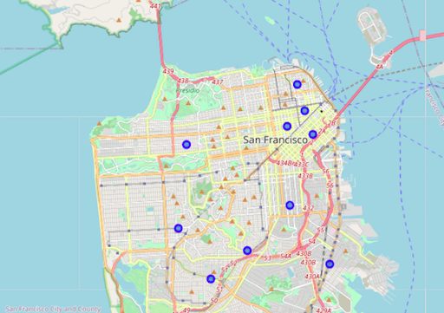
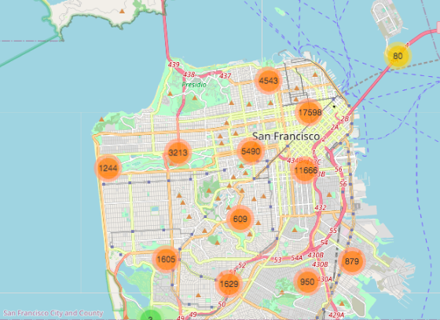
Analysis – Theft incidents by district
We plotted each Police Department District as determined by the geospatial latitude and longitude locations returned by the Nominatim GeoPy function
We read in the total crimes data publicly available by the SF Police Using the Districts data, we aggregated by theft data only and plotted aggregated theft incidents by District
We noticed unusually high theft appears in the North and Eastern regions
Figure 1. Locations by Police Department District
Figure 2. Map of aggregated crimes by District

Slide 6
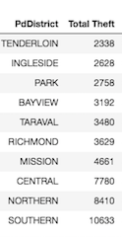
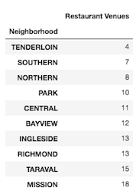
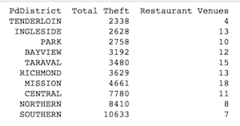
Analysis – venues by district
After data wrangling, we aggregated total theft data by District. Similarly, we aggregated restaurant venues and returned the search results based of the Foursquare API
Further analysis revealed that by joining the total theft and restaurant tables, we were able to rank-sort each District.
By rank-sorting each District on the criteria stipulated by the client, we are able to determine which districts seem most probable for opening a new Sushi restaurant.
Table 1. Total District Theft
Table 2. Restaurant venues by District
Table 3. Joined table for total theft and restaurant venues by District

Slide 7
Results and discussion
The Tenderloin district appears to exhibit the attributes of comparatively minimized theft incidents and fewest restaurant venues compared with other districts in San Francisco
Additional districts the client may wish to consider include the Ingleside and Park districts which seem to have the second and third lowest theft incidents, respectively, throughout the city
While the Southern and Northern districts appears to have the second and third number of restaurant venues in the city, they have nearly four to five times as many theft incidents compared with the lowest ranking districts
Only two factors were considered in this project's scope, namely theft incidents and restaurant venues, which may present limitations to the results.
For theft data, while the Tenderloin may have the lowest theft rates, other crime types, homelessness, or other socioeconomic data may be found to be higher than other districts to the dismay of the client.
For restaurant venues, the data only filtered on restaurant types. Other venues, such as bake shops or bars may have an impact on customer needs as well as adjusting parameters on the Foursquare API.
We therefore further recommend that additional iterations of data analysis be completed to fine-tune the requirements of the client and better serve their business needs

Slide 8
conclusion
This project was initiated on behalf of a client whose business problem required selecting a location in San Francisco, CA to open a new sushi restaurant based on the criteria of fewest theft incidents and minimum adjacent restaurants
Using Foursquare and theft incident data made publicly available by the San Francisco Police Department, we analyzed numerous data sets to conclude that opening a location in the Tenderloin, Ingleside, or Park Districts are optimal locations based on the criteria supplied
As data analysis is an iterative process, we further suggest to run additional analyses to determine if other attributes may present opportunities to fine-tune site selection

